Slide 1
Iowa State University Translational AI Center

Slide 2
Intro to ML/AI with HPC

Slide 3
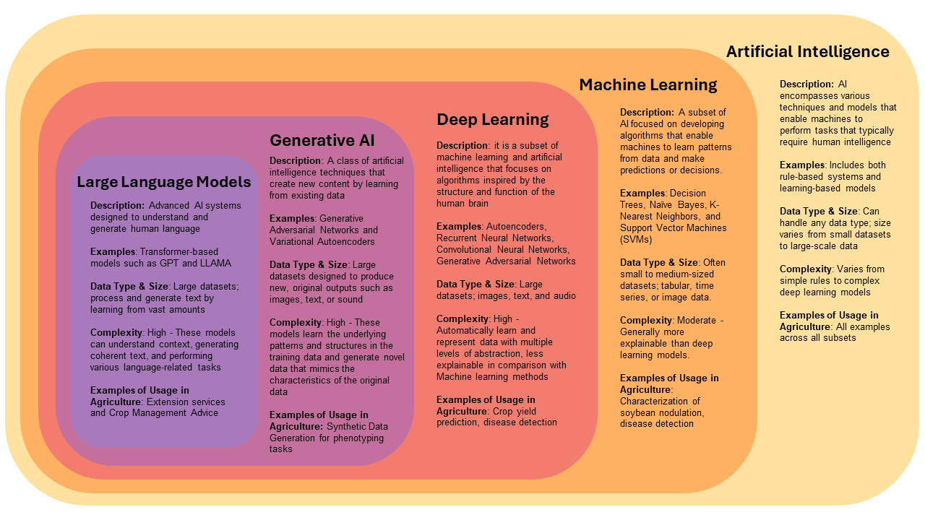
AI
"The training of programs developed by allowing a computer to learn from its experience, rather than through manually coding the individual steps."
fast.ai book
Singh et al. 2024, Use of Artificial Intelligence in Soybean Breeding and Production

Slide 4
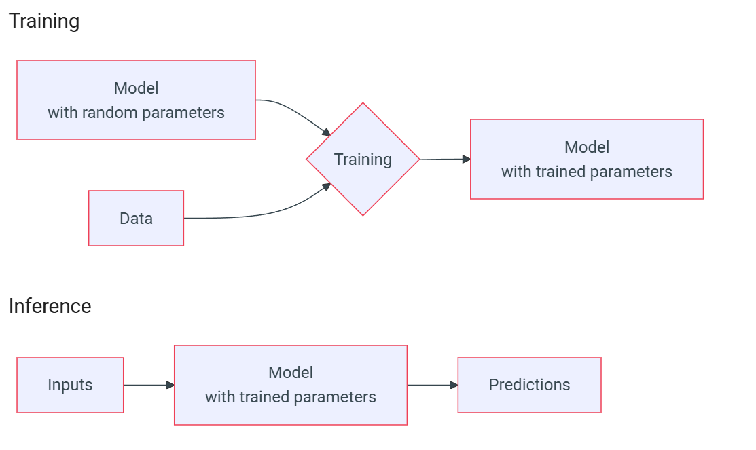
Machine Learning Workflow
https://hpcdocs.hpc.arizona.edu/

Slide 5

What Machine Learning can do?
What can we do with machine learning?
Play chess, go, ..
Classify data: 🐶 vs. 🐱, galaxies, 🐦 species from their calls, ...
Recommender systems: 🎥 / 📚 / 📜 suggestions, ...
Solve
Cluster data into different groups
Write poetry, create art
https://hpcdocs.hpc.arizona.edu/

Slide 6
Things to keep in mind
Computers aren't smart but can be (over)confident
While we do not manually code the individual steps in the program, we still do a lot
We decide which model, data, training hyperparameters, ...
Data is central to machine learning
Untrained models are generally no better than random chance
Trained models often learn biases in data

Slide 7
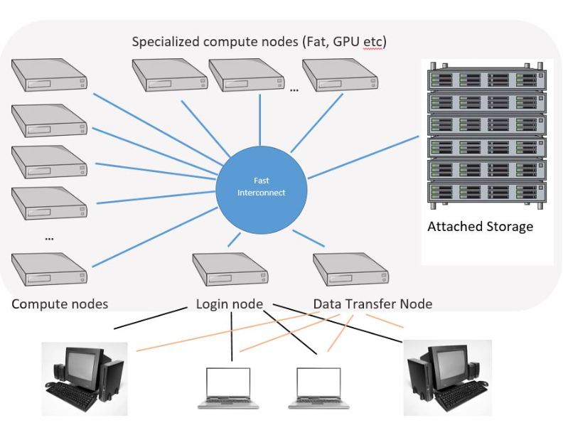
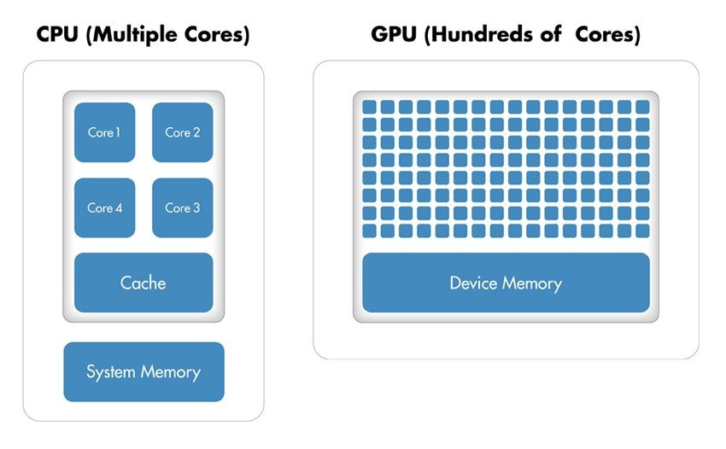
HPC
https://la.mathworks.com/
https://www.hpc.iastate.edu/

Slide 8
AI and HPC: Benefits
Faster Training Times
Larger Model Scalability
Cost-Effective
Improved Accuracy
Larger models can’t be trained without multiple GPUs

Slide 9

Best Practices for Using HPC for Machine Learning
Choose: The Right HPC System
Optimize: Code for HPC
Use: Parallel Processing
Monitor: Performance
Use: Machine Learning Optimized Libraries

Slide 10
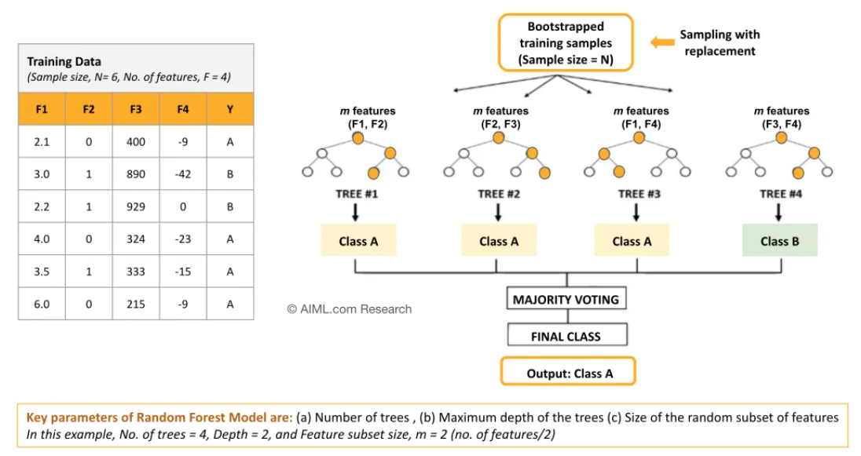
Random Forest for Classification
Source: AL.com

Slide 11
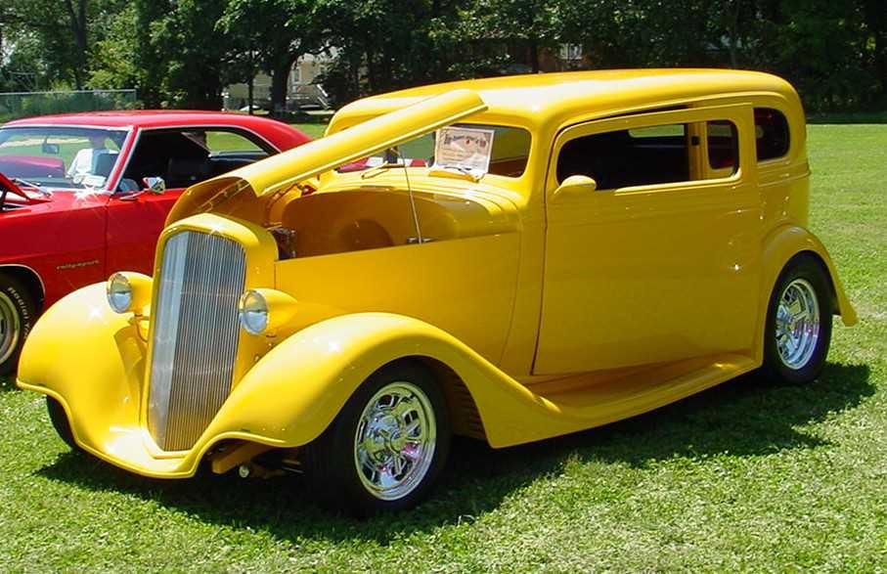
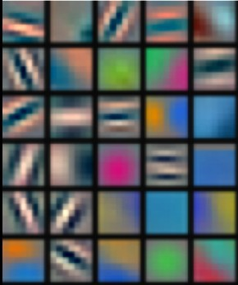
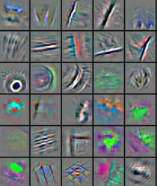
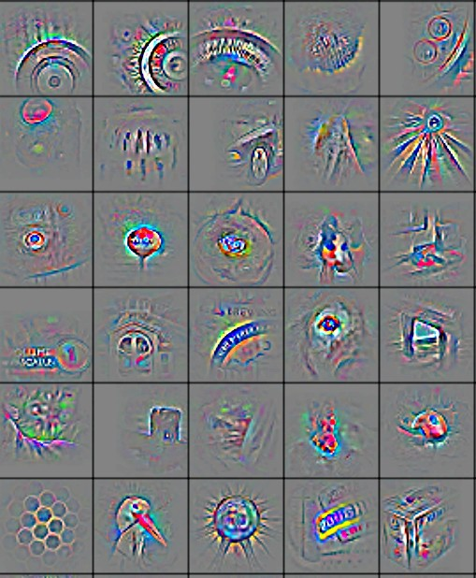
CNN for Classification
Low-level feature
Mid-level feature
High-level feature
Trainable classifier
0.80
0.15
0.05
Car
Bus
Bike
Feature visualization of convolutional net trained on ImageNet from [Zeiler & Fergus 2013]

Slide 12

Interactive Session
Download notebooks from Google Colab
Find libraries along with versions needed
Transfer from the local drive to Nova
Create a Conda environment and install the libraries
Run the notebooks and check time
Convert to Python script and run parallel (random forest)
Run on CPU vs GPU (CNN)

Slide 13
Workshop materials
https://github.com/znjubery/hpc-ai-intro_2025

